Slide 1


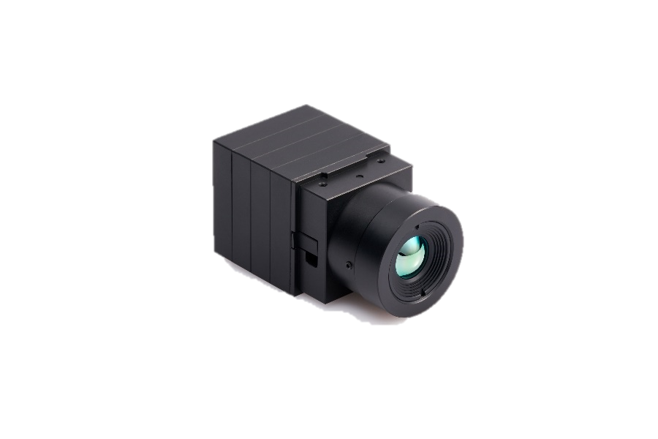

QuantumRed QR
Thermal imaging module for observation
Accuracy
Expandability
Efficiency
Accurate temperature
Measurement and
High quality imaging
Supports various video
Formats for multiple
applications
Low cost, space free,
comfortable,
easy installation
Thermal imaging cameras are less affected by the weather
than general daytime cameras, and can collect observation data
even at night when there is no light.
Key Features
QVGA (320x240) resolution, 30Hz/60Hz
Provides various interfaces such as USB, MIPI, CameraLink, etc.
Use in various fields such as industrial, transportation, ITS, and smart city

Slide 2
QuantumRed QR Module Technical Specifications
Imaging
Sensor Technology | Uncooled Microbolometer
Array Format | QVGA(320X240)
Pixel Pitch | 12 µm
Spectral Range | LWIR 8~14 µm
Thermal Sensitivity (NETD) | <40mK(Premium), <50mK(Industrial), <60mK(General)
Frame Rate | 30Hz/60Hz (EL free)
Shutter | With shutter
Accuracy | N/A
Scene Temp. Range | N/A
Mechanical
Size (mm) | 33.0(W) x 33.0(H) x 24.3(D) without lens / interface Board
Weight | 55g (without lens)
Lens
FOV | 11.5° / 28° / 36° / 42° / 50° / 54.4° / custom
Electrical
Input Voltage | 5.0V
Power Consumption | 1.2W (without Interface Board)
Video Channel | LVCMOS(12/14bit), BT656, BT1120
 | USB(UVC format), Camera-Link(LVDS format), MIPI(CSI-2 format), Analog, Ethernet
Environmental
Operating Temp. | -40℃ ~ +80℃
Storage Temp. | -40℃ ~ +85℃
QuantumRed Part Numbering
1 |  | 2 |  | 3 |  | 4 |  | 5 |  | 6 |  | 7 |  | 8
Main Purpose |  | Resolution |  | Frame/Sec |  | Lens |  | HFOV |  | Grade |  | Temp. Range |  | Interface option
Type | Mark | Type | Mark | Type | Mark | Type | Mark | Type | Mark | Type | Mark | Type | Mark | Type | Mark
Surveillance (Military) | MS | 320*240 | 320A | 30Hz | 3 | Yes | L | 5.9° | 059 | < 40mK | P (Premium) | N/A | 000 | USB | U
 |  |  |  |  |  |  |  | 12.5° | 125
Surveillance | QS |  |  | 60Hz | 6 | No | X | 17.4° | 174 | < 50mK | I (Industrial) |  |  | Camera-Link | C
 |  |  |  |  |  |  |  | 22.8° | 228
 |  |  |  |  |  |  |  | 32° | 320 | < 60mK | G (General) |  |  | MIPI | M
 |  |  |  |  |  |  |  | 61.1° | 611
 |  |  |  |  |  |  |  | 75° | 750 |  |  |  |  | Analog | A
 |  |  |  |  |  |  |  | Custom | 000
 |  |  |  |  |  |  |  |  |  |  |  |  |  | Ethernet | E
 |  |  |  |  |  |  |  |  |  |  |  |  |  | None | N
Part Numbering Sample : QS320A3L059I000U
1 | 2 | 3 | 4 | 5 | 6 | 7 | 8
QS | 320A | 3 | L | 059 | I | 000 | U

Slide 3
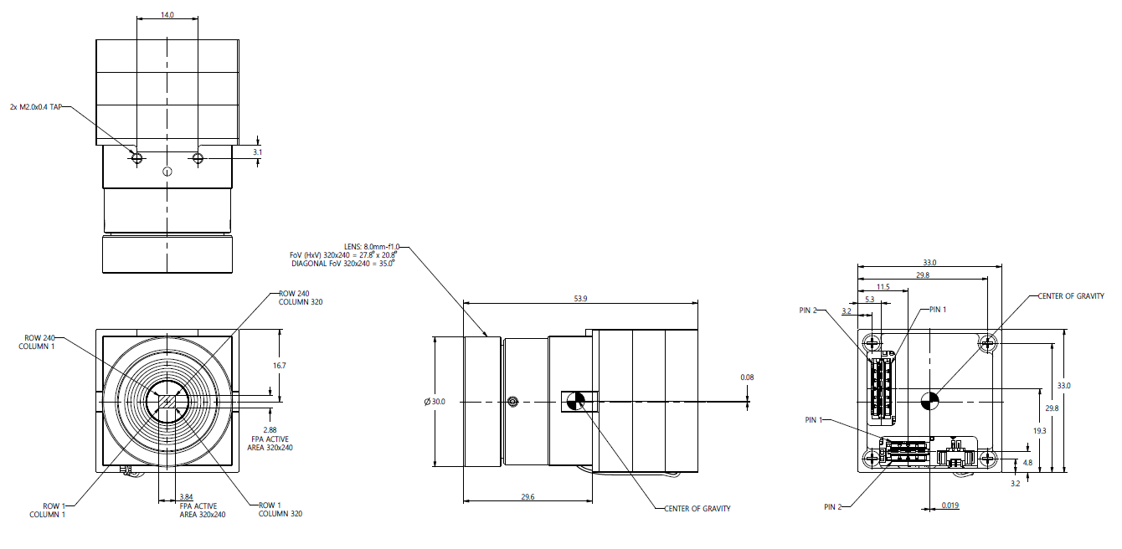
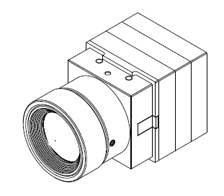
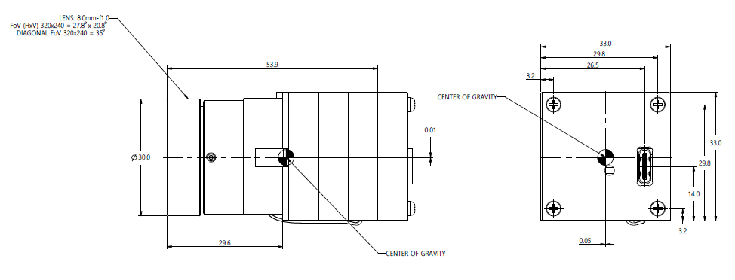
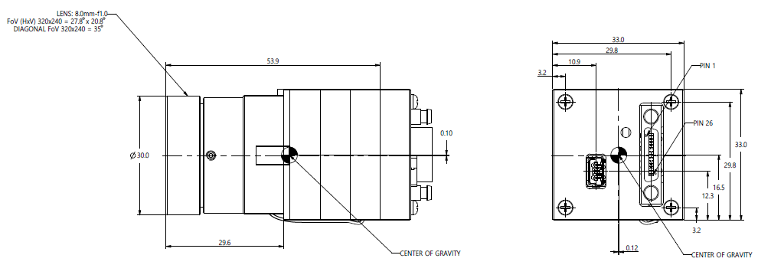
QuantumRed QR Module Dimensions
Base Module Dimension
USB Interface Dimension
Camera-Link Interface Dimension

