Slide 1
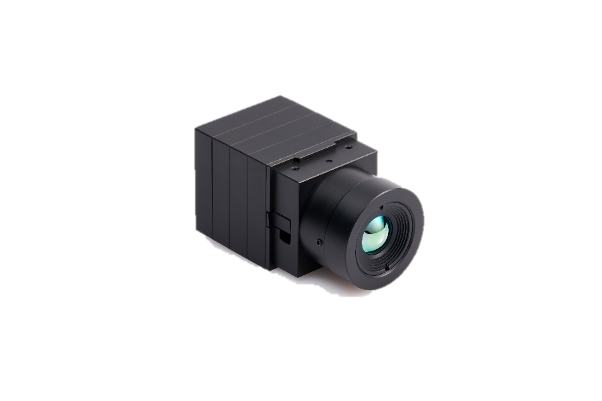
QuantumRed QRT500
For ultra-high temperature measurement
Accuracy
Expandability
Efficiency
Accurate temperature
Measurement and
High quality imaging
Supports various video
Formats for multiple
applications
Low cost, space free,
comfortable,
easy installation
It can measure the temperature uniformly up to 500℃,
so it can be used efficiently in the chemical industry
that develops/produces products through various chemical reactions,
the energy industry that deals with oil and gas,
the power production industry, and the field
where ultra high temperature occurs such as
semiconductor packaging This is possible.
Key Features
QVGA (320x240) resolution, 30Hz/60Hz
Temperature accuracy within ±2℃
Precise temperature measurement up to ~500℃
Provides various interfaces such as USB, MIPI, CameraLink, etc.
Application in various fields such as industrial, chemical, battery, energy, power generation, and semiconductor

Slide 2
QuantumRed QRT500 Module Technical Specifications
Imaging
Sensor Technology | Uncooled Microbolometer
Array Format | QVGA(320X240)
Pixel Pitch | 12 µm
Spectral Range | LWIR 8~14 µm
Thermal Sensitivity (NETD) | <40mK(Premium), <50mK(Industrial), <60mK(General)
Frame Rate | 30Hz / 60Hz (EL free)
Shutter | With shutter
Accuracy | ±2℃ or ±2%
Scene Temp. Range | ~ +500℃
Mechanical
Size (mm) | 33.0(W) x 33.0(H) x 24.3(D) without lens/int. Board
Weight | 55g (without lens)
Lens
FOV | 11.5° / 28° / 36° / 42° / 50° / 54.4° / custom
Electrical
Input Voltage | 5.0V
Power Consumption | 1.2W (without Interface Board)
Video Channel | USB(UVC format), Camera-Link(LVDS format), MIPI(CSI-2 format), Analog, Ethernet
Environmental
Operating Temp. | +10℃ ~ 50℃, customize available
Storage Temp. | -40℃ ~ +85℃
QuantumRed Part Numbering
1 |  | 2 |  | 3 |  | 4 |  | 5 |  | 6 |  | 7 |  | 8
Main Purpose |  | Resolution |  | Frame/Sec |  | Lens |  | HFOV |  | Grade |  | Temp. Range |  | Interface option
Type | Mark | Type | Mark | Type | Mark | Type | Mark | Type | Mark | Type | Mark | Type | Mark | Type | Mark
Temperature | QT | 320*240 | 320A | 30Hz | 3 | Yes | L | 11.5° | 115 | < 40mK | P (Premium) | -20~500℃ | 500 | USB | U
 |  |  |  |  |  |  |  | 28° | 280
 |  |  |  | 60Hz | 6 | No | X | 36° | 360 | < 50mK | I (Industrial) | N/A | 000 | Camera-Link | C
 |  |  |  |  |  |  |  | 42° | 420
 |  |  |  |  |  |  |  | 50° | 500 | < 60mK | G (General) |  |  | MIPI | M
 |  |  |  |  |  |  |  | 54.4° | 544
 |  |  |  |  |  |  |  | Custom | 000 |  |  |  |  | Analog | A
 |  |  |  |  |  |  |  |  |  |  |  |  |  | Ethernet | E
 |  |  |  |  |  |  |  |  |  |  |  |  |  | None | N
Part Numbering Sample : QT320A3L115I500U
1 | 2 | 3 | 4 | 5 | 6 | 7 | 8
QT | 320A | 3 | L | 115 | I | 500 | U

Slide 3
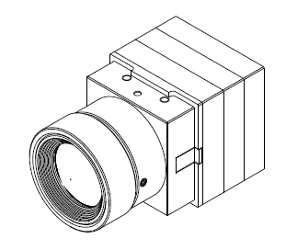
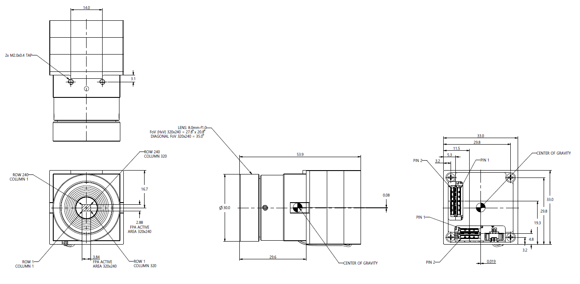
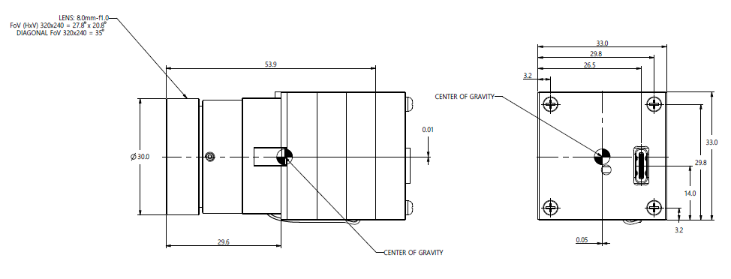
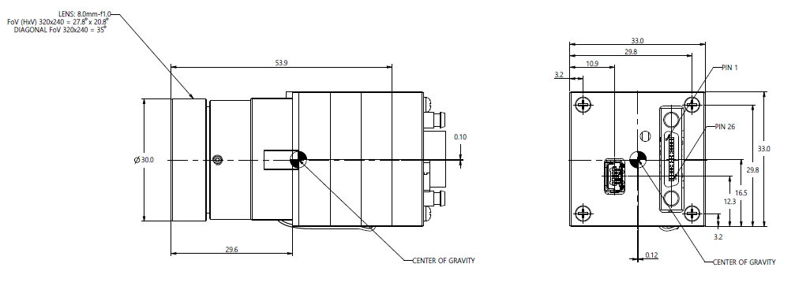
QuantumRed QRT500 Module Dimensions
Base Module Dimension
USB Interface Dimension
Camera-Link Interface Dimension

